Slide 1

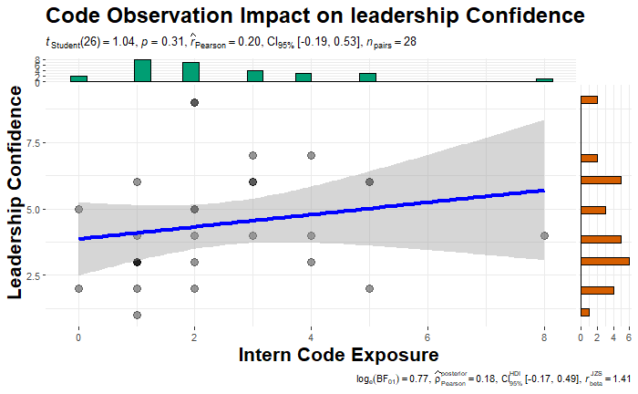
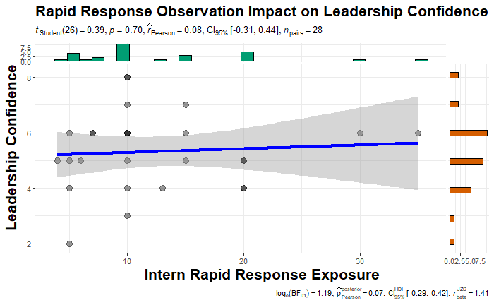
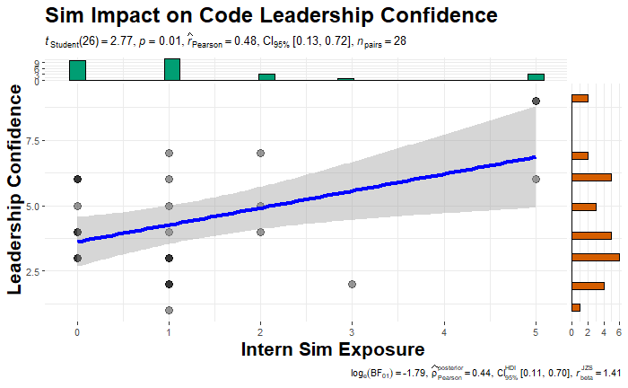
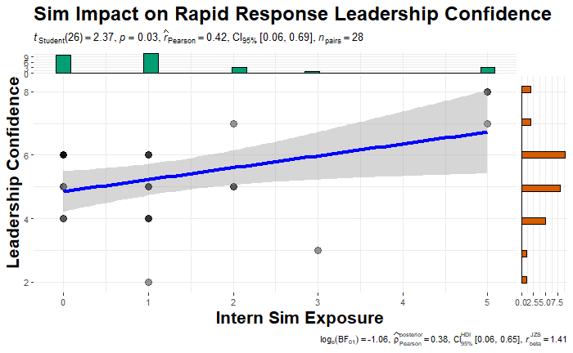
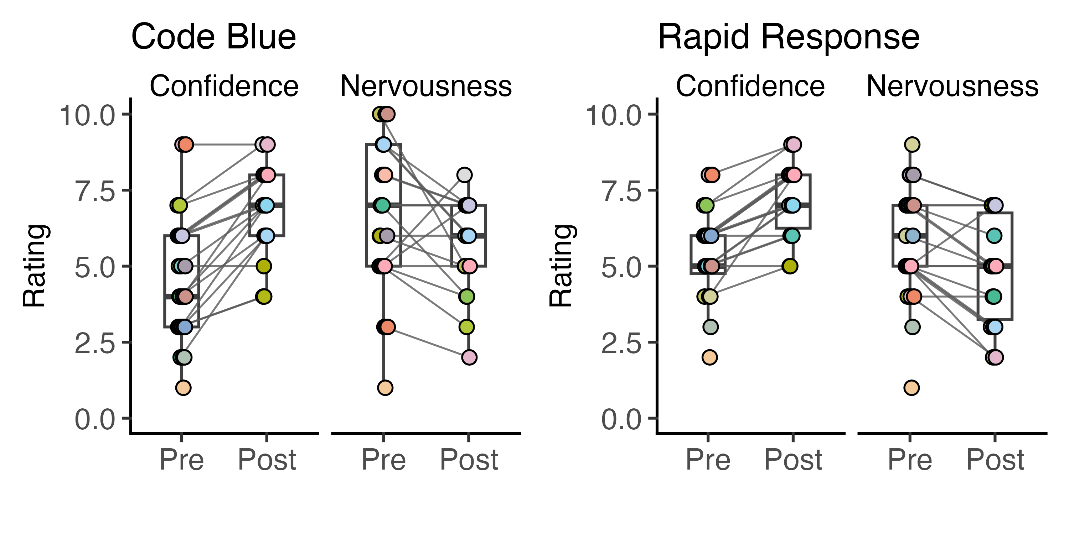
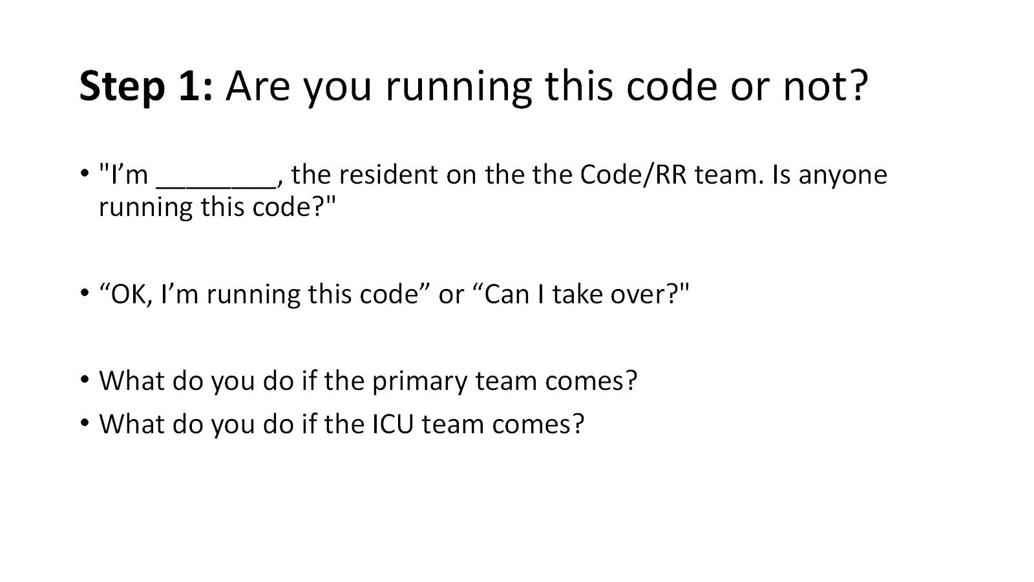
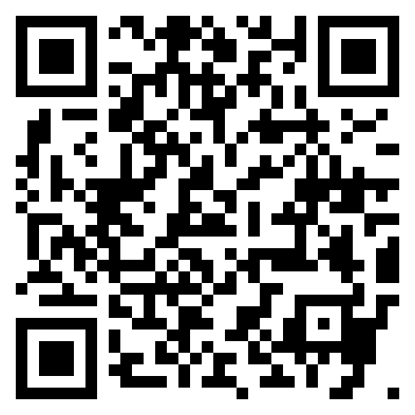
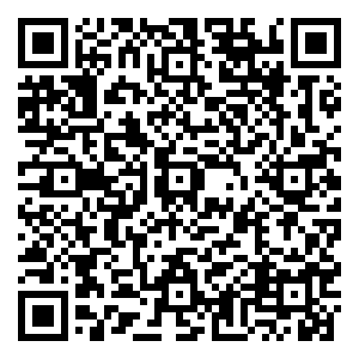

Enhancing Intern Leadership of Inpatient Emergencies: Evaluating the Impact of a Seminar Addressing Team Dynamics
Alex Ryden, MD^{1,2,4}; Ethan Krauspe, MD^{1,3}; Sumit Patel, MD^{1,2}; Rodney Wayne, RN⁴; Mark Davis, RN⁴; Brian Locke, MD, MSc^{1,2,5}
1- University of Utah School of Medicine, 2- Division of Pulmonary, Critical Care, and Occupational Medicine, 3- Internal Medicine Residency, University of Utah, 4- Salt Lake City Veterans Affairs, 5- Intermountain Medical Center, Department of Pulmonary and Critical Care
Background:
Training residents to lead in-hospital emergency and cardiac arrest responses is challenging due to event rarity, high stress, and complex, difficult-to-simulate team dynamics^{1,2,3}.
A needs assessment across our three hospitals (University of Utah, Salt Lake City VA, Intermountain Medical Center) identified poor team dynamics, rather than knowledge gaps, as the main contributor to ineffective responses.
We developed a targeted curriculum to enhance residents’ leadership skills and improve patient care.
Results
Table 2: Seminar Participation and Pre-Seminar Exposures
Images 1-4: Association between Pre-Seminar Confidence and Event Attendance, Linear Regression
Total Number of Residents in Attendance | 28
- Pre-Lecture Survey Completion | 100%
- Post-Lecture Survey Completion | 64%
Simulation Exposure (average) | 1 (IQR 0-1.25)
Rapid Response Exposure (average) | 10 (IQR 7-16.25)
Code Blue Exposure (average) | 2 (IQR 1-3.25)
Method and Format:
2-hour seminar to end-of-year categorical interns
5 ~15 minute modules on leadership microskills, 1-hands on session with equipment.
Pre- and post- test surveys on prior experiences, confidence and nervousness.
Paired t-test and separate linear regressions to relate number of prior experiences and confidence/nervousness
Image 2: Pre-Seminar and Post-Seminar Changes in
Nervousness and Confidence, Paired T-test
Seminar Format
Table 1: Seminar Modules
Module 1 | Leadership Style and Team Dynamics
Module 2 | Pulse-Check Decisions
Module 3 | Equipment and Personnel Organization
Module 4 | Identifying the Cause: Decision Making
Module 5 | Ending the Code
Module 6 | Defibrillator Simulation and Debrief
Discussion:
Interns at our program were exposed to few code blue events, with real or simulated exposure associated with more confidence and less nervousness.
Targeted modules on leadership microskills had a positive impact on resident perception of their confidence in delivering care and on their nervousness in taking on leadership during code blues and rapid responses
This indicates that appropriately developed educational material can improve resident attitudes towards leadership if the appropriate barriers are addressed.
Our pre-seminar data also offers some support towards the benefit of simulation training in health education
Future studies should aim to examine how this improvement in attitude correlates with leadership performance during events.
Example
Material:
Link to
Seminar
Materials:
Link to
Code Base:
Limitations:
One residency program; some constraints may be unique to our program
Attitudes rather than outcomes assessed
The survey, knowledge questions, and lecture materials were designed by the study authors and are not validated instruments.
References:
EPERJESIOVA, B., MIKRUT, K., & KATZMAN, D. (2018). Improving internal medicine residents’ preparedness and confidence levels in responding to rapid response calls through targeted education tool. Chest, 154(4). https://doi.org/10.1016/j.chest.2018.08.489
Ghantarchyan, H., Phan, A. T., Toor, J., Qadir, A., Malkoc, A., Gukasyan, J., & Arabian, S. (2024). Improving a rapid response system at a teaching hospital. CHEST. https://doi.org/10.1016/j.chest.2024.10.055
Steinbach, T. C., Jennerich, A. L., & Çoruh, B. (2024). Effective behaviors of leaders during clinical emergencies. CHEST, 166(5), 1141–1150. https://doi.org/10.1016/j.chest.2024.05.011

Slide 2
